Slide 1
SS ZG622:
Software Project Management
(Project Goals, Metrics)
K G Krishna, BITS-Pilani, Off-campus Centre, Hyderabad

Slide 2
Project Goal Setting (Objectives) & Metrics
Source Courtesy: Some of the contents of this PPT are sourced from materials provided by Publishers of T1 & T2

Slide 3


Text Books
T1: Pressman, R.S. Software Engineering : A Practitioner’s Approach, 7th Edition, TMH, 2010
T2: Hughes, B and Cotterel, M., Software Project Management, 11th Edition, TMH, 2011
S1: Frank Tsui, Managing Software Projects, Jones&Bartlett, 2011
S2: Pankaj Jalote, Software Project Management in Practice, Pearson Education, 2002
Note: In order to broaden understanding of concepts as applied to Indian IT industry, students are advised to refer books of their choice and case-studies in their own organizations

Slide 4
Software Project Categories
Distinguishing different types of project is important as different types need different project approaches/development models e.g.
Commercial systems (ERP Systems)
Consumer systems (video games, mobile apps)
Embedded Systems
Real-Time Systems
Mission-critical Systems
Custom developed (bespoke) Systems
Software Products (off-the-shelf)
Software project management (5e) - introduction © The McGraw-Hill Companies, 2009
Notes:
With objective-based projects, a general objective or problem is defined, and there are several different ways in which that objective could be reached. The project team have freedom to select what appears to be the most appropriate approach.
With product-based projects, the product is already very strictly defined and the development team’s job is to implement the specification with which they have been presented.
Arguably, information systems projects are more likely to be objective-based than is the case with software engineering.
In many cases, an objective-based project could consider a problem and recommend a solution that is then implemented by a product-based project.
Exercise 1.5 in the text is relevant here.

Slide 5
Project Stakeholders
These are people who have a stake or interest in the project
In general, they could be users/customers or developers/implementers
Customer: Key Stakeholder
Others could be:
  Within the project team (Team members, PM)
  Outside the project team, but within the same organization (Finance, Business,…)
  Outside both the project team and the organization (society)
Different stakeholders may have different objectives – need to define common project objectives
Notes:
Each stakeholder will have their own goals and concerns in relation to the project which may be different from those of the project as a whole. For example, a software developer might work to make a living, pay the mortgage, learn new things, solve interesting problems. The main stakeholders need, however, to understand and accept overall project objectives that everyone can agree to.
See Exercise 1.6 in the text.

Slide 6
Setting Project Goals (Objectives)
Answering the question ‘What do we have to do to have a success?’
Set by a project authority
  Sets the project scope
  Allocates/approves costs
  Could be one person - or a group
    Project Board
    Project Management Board
    Steering committee
Software project management (5e) - introduction © The McGraw-Hill Companies, 2009
Notes:
Different people who are involved in a project (Stakeholders) will have different interests in the project and are likely to see different outcomes as being important.
For example, end-users would want a system that is ‘user-friendly’, that is, easy to learn and to use, and a system that helps rather than hinders them from doing their jobs. Their managers may be more interested in whether the new system would allow them to reduce staffing levels.
It is important therefore that a set of clearly defined objectives are identified and published for the project. Some individual or group needs to be pinpointed who acts as the main client for the project.
See Exercise 1.7 in the text.

Slide 7
Objectives
Informally, the objective of a project can be defined by completing the statement:
The project will be regarded as a success if……….
…………
Focus on what will be put in place, rather than how activities will be carried out
Notes:
The focus here needs to be on what the situation will be when the project is completed. In what ways will the world be different? The objectives should avoid describing activities:
e.g. ‘a new payroll application will be operational by 4th April’ not ‘design and code a new payroll application’

Slide 8
Objectives should be SMART
S – specific, that is, concrete and well-defined
M – measurable, that is, satisfaction of the objective can be objectively judged
A – achievable, that is, it is within the power of the individual or group concerned to meet the target
R – relevant, the objective must relevant to the true purpose of the project
T – time constrained: there is defined point in time by which the objective should be achieved
Notes:
I have seen some places where the R is said to stand for ‘resource-constrained’, that is that there is a target cost associated with the achievement of the objective.

Slide 9
Goals/sub-objectives
These are steps along the way to achieving the objective
Informally, these can be defined by completing the sentence
To reach objective X, the following must be in place
A……………
B……………
C…………… etc
Notes:
Scoring a goal in football is a ‘goal’ or sub-objective on the way to achieving the overall objective of winning the match. Sub-objectives and objectives can be nested in a hierarchy, so that the objective of winning the match could itself be a goal or sub-objective on the way to winning the league etc.

Slide 10
Goals/sub-objectives …continued
Often a goal can be allocated to an individual
Individual might have the capability of achieving goal on their own, but not the overall objective e.g.
  Overall objective – user satisfaction with software product
  Analyst goal – accurate requirements
  Developer goal – reliable software
Notes:
Goals can be formulated in such a way that they represent what an individual or group need to do to contribute to the success of the project’s objectives.
In the example above, the analyst or developer, by themselves, cannot guarantee user satisfaction. However, the analyst can contribute to the achievement of the objective by making sure the users’ requirements are accurately recorded and the developer by making sure that the software is reliable.
See Exercise 1.7 in the text.

Slide 11
Measures of effectiveness
How do we know that the goal or objective has been achieved?
By a practical test, that can be objectively assessed.
  e.g. for user satisfaction with software product:
  Repeat business – they buy further products from us
  Number of complaints – if low etc etc
Notes:
See Exercise 1.8 in the text.

Slide 12
The Business Case
(Cost vs. Benefit)
Benefits of delivered project must outweigh costs
Costs include:
  Development
  Operation
Benefits
  Quantifiable
  Non-quantifiable
Benefits
Rs.
Costs
Rs.
Notes:
It is not always possible to put a precise financial on the benefits of a project. The client’s willingness to pay up to a certain price to get a project implemented implies that they have informally identified a value to them of getting that project implemented.

Slide 13
Project Success/Failure
Degree to which objectives are met
Quality, Scope (of deliverables)
time
cost
In general if, for example, project is running out of time,
this can be recovered for by reducing scope or increasing
costs. Similarly costs and scope can be protected by
adjusting other corners of the ‘project triangle’.

Slide 14
Other success criteria
These can relate to longer term, less directly tangible assets
  Improved skill and knowledge
  Creation of assets that can be used on future projects e.g. software libraries
  Improved customer relationships that lead to repeat business

Slide 15
Managing for Success
Management is all about:
Planning – deciding what is to be done
Organizing – making arrangements
Staffing – selecting the right people for the job (motivating for performance)
Directing – giving instructions
Measuring – Defining Metrics and establishing baselines
Monitoring – checking on progress
Controlling – taking action to remedy bottle-necks
Innovating – coming up with solutions when problems emerge
Representing – liaising with customers, users, developers and other stakeholders
…
Notes:
This list is based on one that can be found in Introduction to Software Project Management and Quality Assurance by Darrel Ince, Helen Sharp and Mark Woodman, McGraw-Hill, 1993.

Slide 16
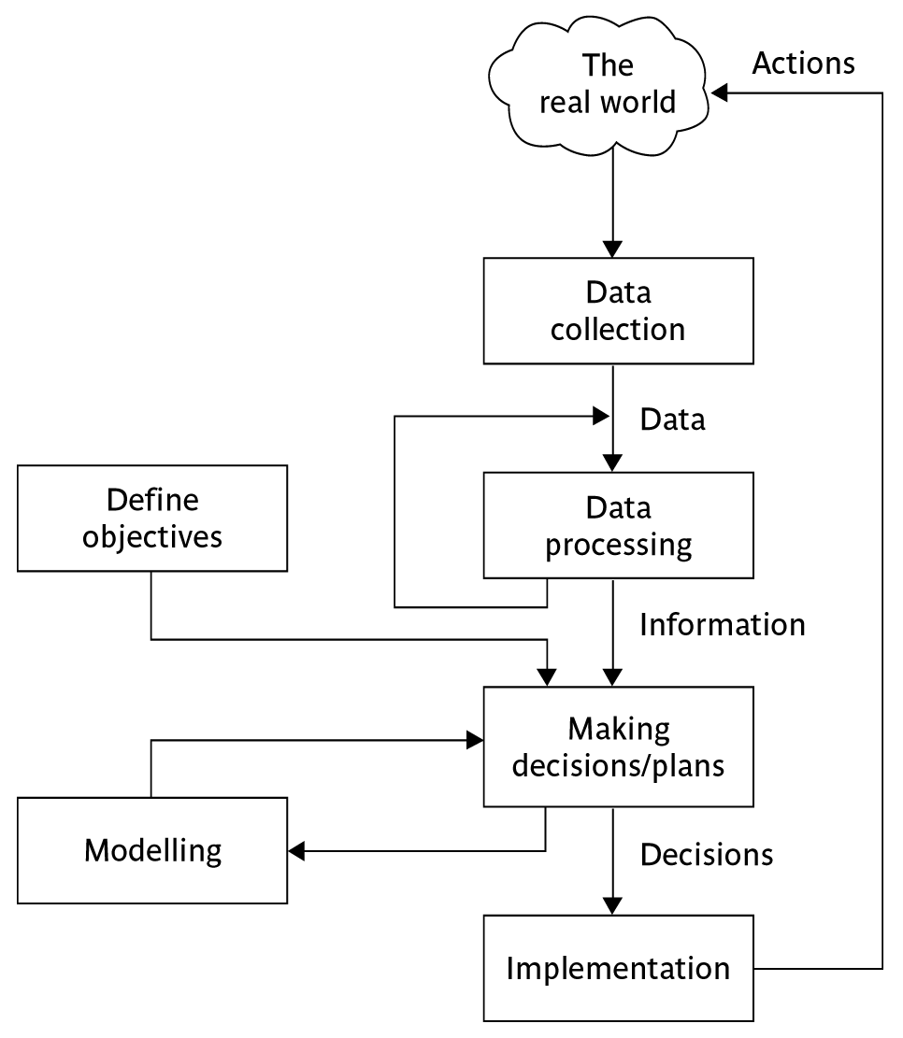
Data, Measurements & Management control
Software project management (5e) - introduction © The McGraw-Hill Companies, 2009
Notes:
This is explained on the next overhead.

Slide 17
Management control
Data – the raw details
  e.g. ‘6,000 documents processed at location X’
Information – the data is processed to produce something that is meaningful and useful
  e.g. ‘productivity is 100 documents a day’
Comparison with objectives/goals
  e.g. we will not meet target of processing all documents by 31st March
  Modelling – working out the probable outcomes of various decisions
  e.g. if we employ two more staff at location X how quickly can we get the documents processed?
  Implementation – carrying out the remedial actions that have been decided upon
Notes:
This example is expanded in the text.

Slide 18
Objectives, Project Control:
Summary
Projects are non-routine - thus uncertain
Clear objectives which can be objectively assessed are essential
Things work! Not usually possible to keep precisely plan – need for control
Communicate, communicate, communicate!

Slide 19
Thank You

